Slide 1
CENG401 MACHINE LEARNING AND ARTIFICIAL INTELLIGENCE
WEEK-5
Adversarial Search
Asst.Prof.Dr. Murat ŞİMŞEK

Slide 2
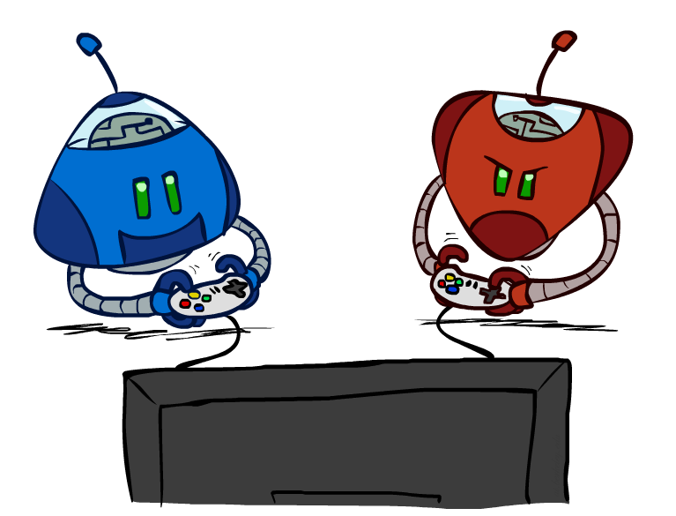
ADVERSARIAL SEARCH
Adversarial search is basically a kind of search in which one can trace the movement of an enemy or opponent.
Notes:
Adversarial search is basically a kind of search in which one can trace the movement of an enemy or opponent. The step which arises the problem for the user or the user or the agent doesn't want that specific step task to be carried out.

Slide 3
ADVERSARIAL SEARCH
Adversarial search is a search, where we examine the problem which arises when we try to plan ahead of the world and other agents are planning against us.
However, there may be times when more than one agent is searching for the same answer in the same search space, which is common in game play.
The environment with more than one agent is referred to as a multi-agent environment, in which each agent is an adversary to the other and competes against them.
Each agent must consider the actions of other agents as well as the consequences of their actions.
Each agent have to consider the action of the other agent and effect of that action on their performance.

Slide 4
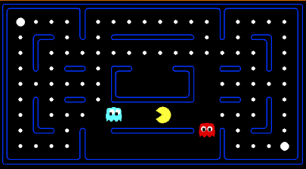
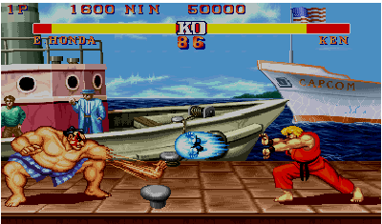
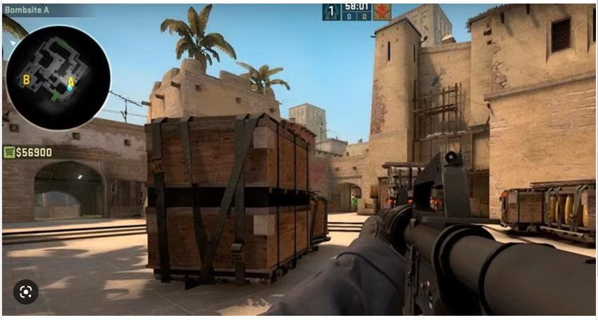
Games

Slide 5
Games
Multi agent environments : any given agent will need to consider the actions of other agents and how they affect its own welfare.
The unpredictability of these other agents can introduce many possible contingencies.
There could be competitive or cooperative environments
Competitive environments, in which the agent’s goals are in conflict require adversarial search – these problems are called as GAMES

Slide 6
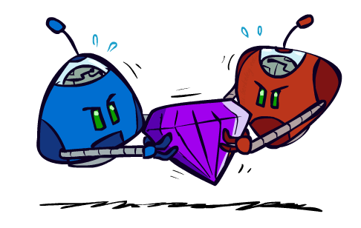
Games

Slide 7
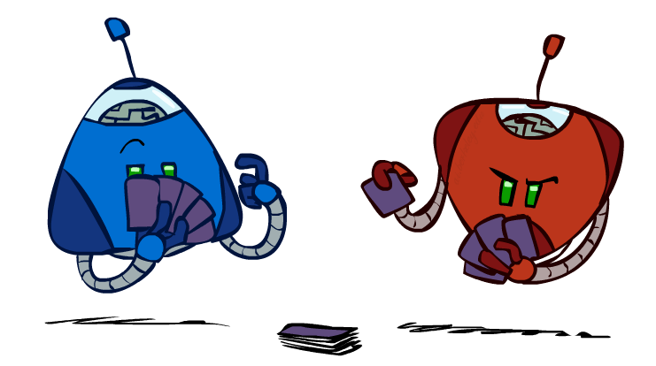
Games
Many different kinds of games!
Deterministic or stochastic
One, two, or more players
Zero sum
Perfect information

Slide 8
Games
 | Deterministic | Chance Moves
Perfect Information | Chess, Go | Backgammon, Monopoly
Imperfect Information | Battleship, Tic-Tac-Toe | Poker, Scrabble
Deterministic games: Deterministic games are those games which follow a strict pattern and set of rules for the games, and there is no randomness associated with them.
Examples are chess, Checkers, Go, tic-tac-toe, etc.
Non-deterministic games: Non-deterministic are those games which have various unpredictable events and has a factor of chance or luck.
This factor of chance or luck is introduced by either dice or cards.
These are random, and each action response is not fixed.
Such games are also called as stochastic games.
Example: Backgammon, Monopoly, Poker, etc.

Slide 9
Games
 | Deterministic | Chance Moves
Perfect Information | Chess, Go | Backgammon, Monopoly
Imperfect Information | Battleship, Tic-Tac-Toe | Poker, Scrabble
Perfect information: A game with the perfect information is that in which agents can look into the complete board.
Agents have all the information about the game, and they can see each other moves also.
Examples are Chess, Go, etc.
Imperfect information: If in a game agents do not have all information about the game and not
aware with what's going on, such type of games are called the game with imperfect information, such as tic-tac-toe, Battleship, etc.

Slide 10
Game Search Problem
Problem formulation
Initial state: initial board position + whose move it is
Operators: legal moves a player can make
Goal (terminal test): game over?
Utility (payoff) function: measures the outcome of the game and its desirability
Search objective:
Find the sequence of player’s decisions (moves) maximizing its utility (payoff)
Consider the opponent’s moves and their utility

Slide 11
Game Search Problem
Problem formulation
Initial state: initial board position + whose move it is
Operators: legal moves a player can make
Goal (terminal test): game over?
Utility (payoff) function: measures the outcome of the game and its desirability
Search objective:
Find the sequence of player’s decisions (moves) maximizing its utility (payoff)
Consider the opponent’s moves and their utility

Slide 12
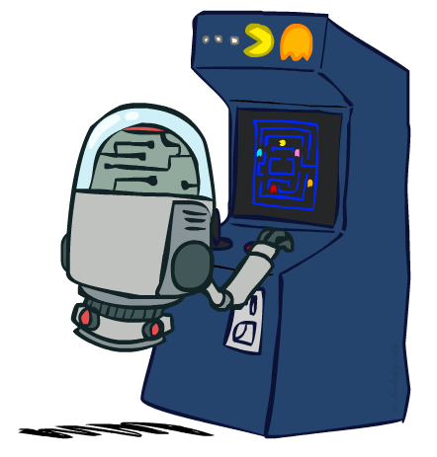
Deterministic Games
Many possible formalizations, one is:
States: S (start at s₀)
Players: P={1...N} (usually take turns)
Actions: A (may depend on player / state)
Transition Function: SxA → S
Terminal Test: S → {t,f}
Terminal Utilities: SxP → R
Solution for a player is a policy: S → A

Slide 13
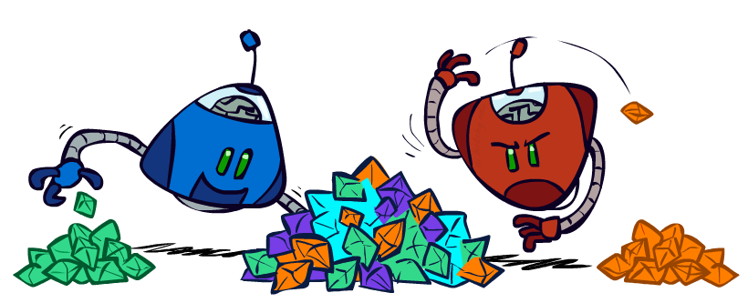
Zero-Sum Games
Zero-Sum Games
Agents have opposite utilities (values on outcomes)
Lets us think of a single value that one maximizes and the other minimizes
Adversarial, pure competition
General Games
Agents have independent utilities (values on outcomes)
Cooperation, indifference, competition, and more are all possible
More later on non-zero-sum games

Slide 14

Adversarial Search

Slide 15
Zero-Sum Game
A zero-sum game is a mathematical representation of a situation in which a participant's gain (or loss) of utility is exactly balanced by the losses (or gains) of the utility of other participant(s)
Zero-sum games are adversarial search which involves pure competition.
In Zero-sum game each agent's gain or loss of utility is exactly balanced by the losses or gains of utility of another agent.
One player of the game try to maximize one single value, while other player tries to minimize it.
Each move by one player in the game is called as ply.
Chess and tic-tac-toe are examples of a Zero-sum game.

Slide 16
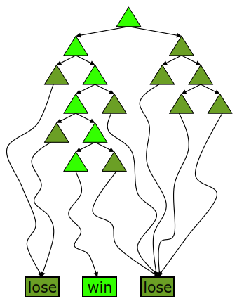
Deterministic Single-Player
Deterministic, single player, perfect information:
Know the rules
Know what actions do
Know when you win
E.g. Freecell, 8-Puzzle, Rubik’s cube
… it’s just search!
Slight reinterpretation:
Each node stores a value: the best outcome it can reach
This is the maximal outcome of its children (the max value)
Note that we don’t have path sums as before (utilities at end)
After search, can pick move that leads to best node
Slide adapted from Macskassy

Slide 17
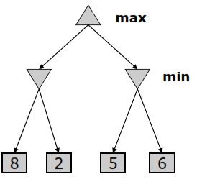
Deterministic Two-Player
E.g. tic-tac-toe, chess, checkers
Zero-sum games
One player maximizes result
The other minimizes result
Minimax search
A state-space search tree
Players alternate
Each layer, or ply, consists of a round of moves
Choose move to position with highest minimax value = best achievable utility against best play
Slide adapted from Macskassy

Slide 18
Searching for the next move
Complexity: many games have a huge search space
Chess: b = 35, m=100 nodes = 35 ¹⁰⁰
if each node takes about 1 ns to explore then each move will take about 10⁵⁰ millennia to calculate.
Resource (e.g., time, memory) limit: optimal solution not feasible/possible, thus must approximate
1. Pruning: makes the search more efficient by discarding portions of the search tree that cannot improve quality result.
2. Evaluation functions: heuristics to evaluate utility of a state without exhaustive search.
Slide adapted from Macskassy

Slide 19
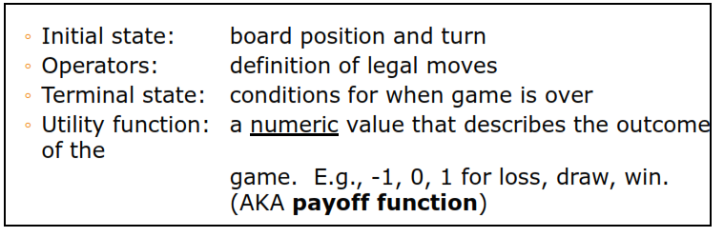
Two-player Games
A game formulated as a search problem:
Slide adapted from Macskassy

Slide 20
Game Tree
A game tree is a tree where nodes of the tree are the game states and Edges of the tree are the moves by players.
Game tree involves initial state, actions function, and result Function.

Slide 21
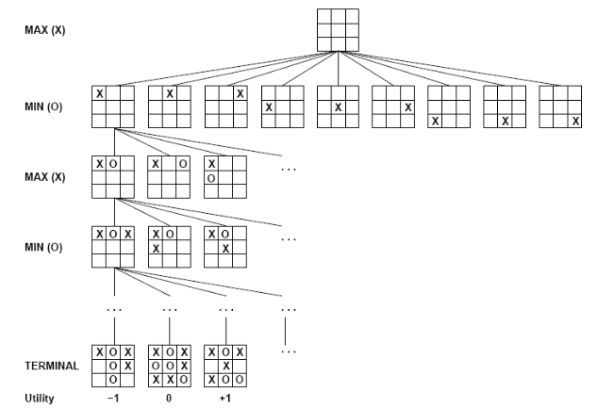
Example: Tic-Tac-Toe
There are two players MAX and MIN.
Players have an alternate turn and start with MAX.
MAX maximizes the result of the game tree
MIN minimizes the result.
Notes:
There are two players MAX and MIN.
Players have an alternate turn and start with MAX.
MAX maximizes the result of the game tree
MIN minimizes the result.

Slide 22
The minimax algorithm
Perfect play for deterministic environments with perfect information
Basic idea: choose move with highest minimax value
= best achievable payoff against best play
Algorithm:
1. Generate game tree completely
2. Determine utility of each terminal state
3. Propagate the utility values upward in the three by applying MIN and MAX operators on the nodes in the current level
4. At the root node use minimax decision to select the move with the max (of the min) utility value
Steps 2 and 3 in the algorithm assume that the opponent will play perfectly.

Slide 23
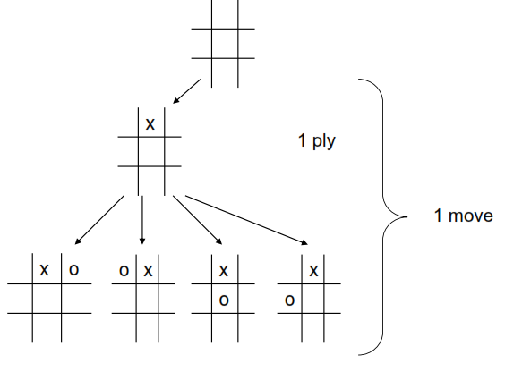
Generate Game Tree

Slide 24
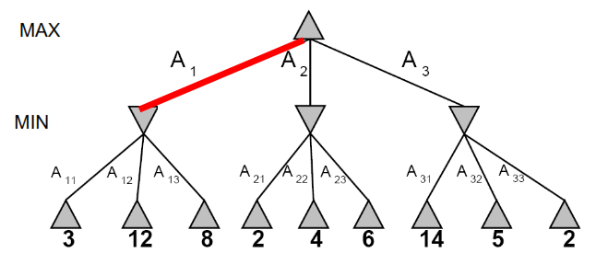
Minimax Example

Slide 25
Minimax value
Given a game tree, the optimal strategy can be determined by examining the minimax value of each node (MINIMAX-VALUE(n))
The minimax value of a node is the utility of being in the corresponding state, assuming that both players play optimally from there to the end of the game
Given a choice, MAX prefer to move to a state of maximum value, whereas MIN prefers a state of minimum value

Slide 26
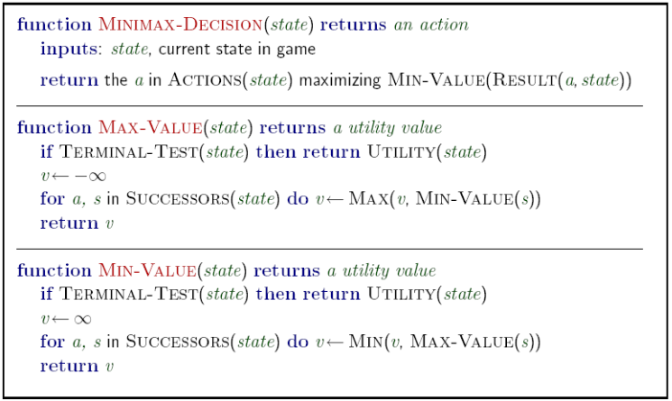
Minimax: Recursive implementation

Slide 27
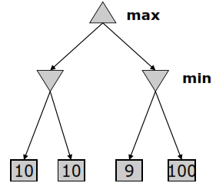
The Minimax Algorithm Properties
Performs a complete depth-first exploration of the game tree
Optimal against a perfect player.
Time complexity?
O(b^{m})
Space complexity?
O(bm)
For chess, b ~ 35, m ~ 100
Exact solution is completely infeasible
But, do we need to explore the whole tree?
Minimax serves as the basis for the mathematical analysis of games and for more practical algorithms

Slide 28
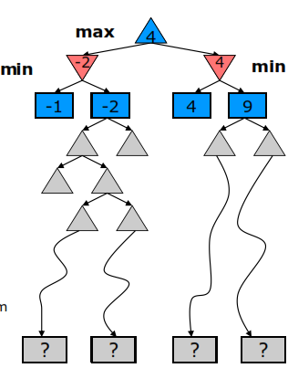
Resource Limits
Cannot search to leaves
Depth-limited search
Instead, search a limited depth of tree
Replace terminal utilities with an eval function for non-terminal positions
Guarantee of optimal play is gone
More plies makes a BIG difference
Example:
Suppose we have 100 seconds, can explore 10K nodes / sec
So can check 1M nodes per move
α-β reaches about depth 8 – decent chess program
Slide adapted from Macskassy

Slide 29
Alpha-Beta Pruning
General configuration (MIN version)
We’re computing the MIN-VALUE at some node n
We’re looping over n’s children
n’s estimate of the childrens’ min is dropping
Who cares about n’s value? MAX
Let a be the best value that MAX can get at any choice point along the current path from the root
If n becomes worse than a, MAX will avoid it, so we can stop considering n’s other children (it’s already bad enough that it won’t be played)
MAX version is symmetric
MAX
MIN
a
MAX
MIN
n

Slide 30
Alpha-Beta Implementation
α: MAX’s best option on path to root
β: MIN’s best option on path to root
def max-value(state, α, β):
initialize v = -∞
for each successor of state:
v = max(v, value(successor, α, β))
if v ≥ β return v
α = max(α, v)
return v
def min-value(state , α, β):
initialize v = +∞
for each successor of state:
v = min(v, value(successor, α, β))
if v ≤ α return v
β = min(β, v)
return v
Notes:
Pick an order for two reasons: sequential processor and pruning

Slide 31
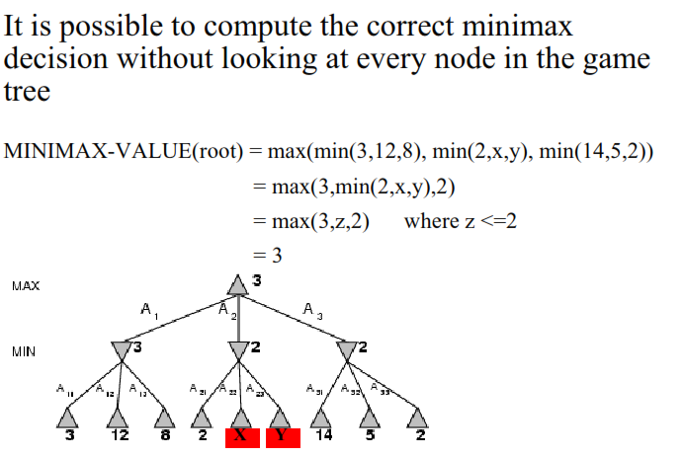
α-β pruning

Slide 32
Alpha-Beta Pruning Properties
This pruning has no effect on minimax value computed for the root!
Values of intermediate nodes might be wrong
Important: children of the root may have the wrong value
So the most naïve version won’t let you do action selection
Good child ordering improves effectiveness of pruning
With “perfect ordering”:
Time complexity drops to O(b^{m/2})
Doubles solvable depth!
Full search of, e.g. chess, is still hopeless…
This is a simple example of metareasoning (computing about what to compute)
max
min
10
10
0

Slide 33
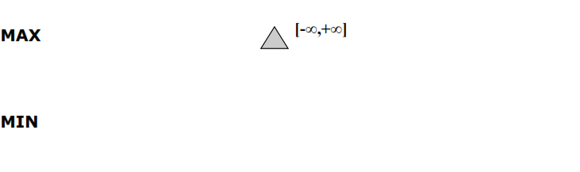
α-β pruning: example

Slide 34
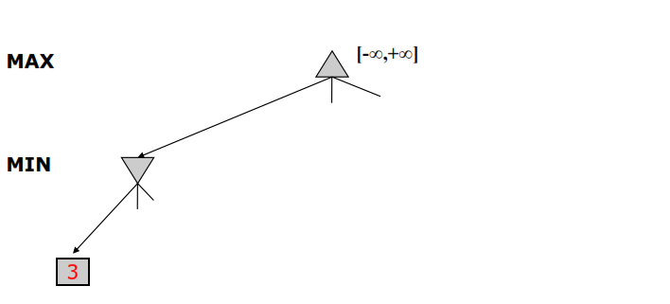
α-β pruning: example

Slide 35
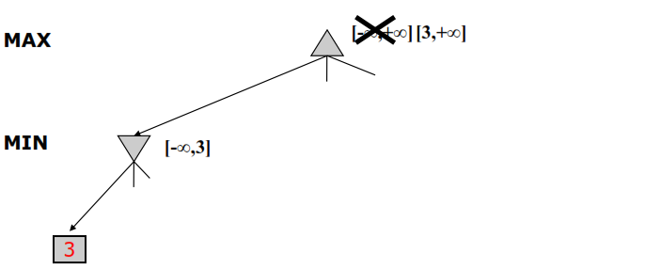
α-β pruning: example

Slide 36
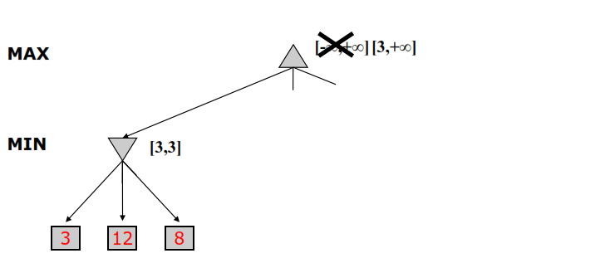
α-β pruning: example

Slide 37
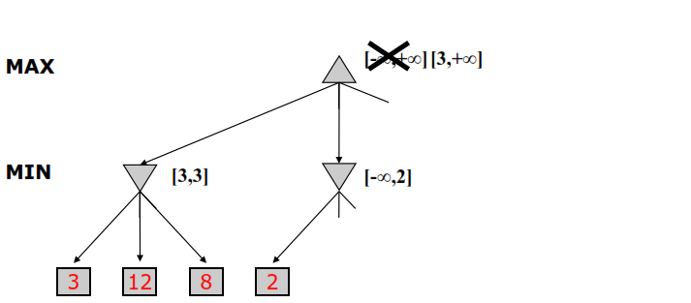
α-β pruning: example

Slide 38
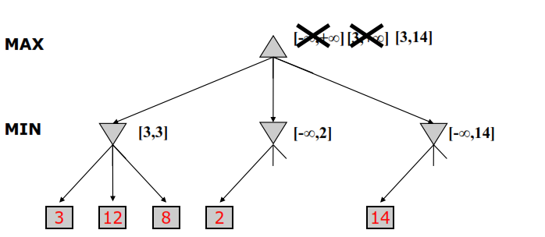
α-β pruning: example

Slide 39
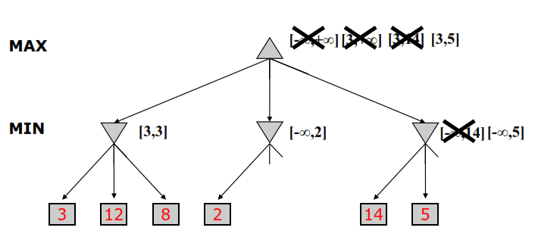
α-β pruning: example

Slide 40
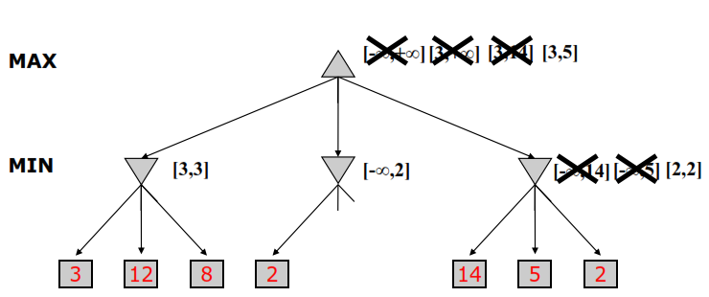
α-β pruning: example

Slide 41
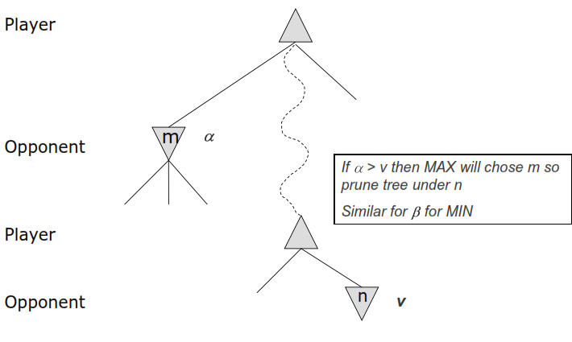
α-β pruning: General Principle

Slide 42
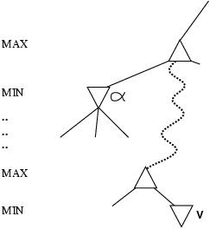
Why is it called α-β?
α is the value of the best (i.e., highest-value) choice found so far at any choice point along the path for max
If v is worse than α, max will avoid it
→ prune that branch
Define β similarly for min

Slide 43
Imperfect Real-Time Decisions
Suppose we have 100 secs, explore 10⁴ nodes/sec → 10⁶ nodes per move
Standard approach:
cutoff test:
e.g., depth limit (perhaps add quiescence search)
evaluation function
= estimated desirability of position
* Replace the utility function by a heuristic evaluation function EVAL, which gives an estimate of the position’s utility

Slide 44
Evaluation Functions
First proposed by Shannon in 1950
The evaluation function should order the terminal states in the same way as the true utility function
The computation must not take too long
For non-terminal states, the evaluation function should be strongly correlated with the actual chances of winning
Uncertainty introduced by computational limits

Slide 45
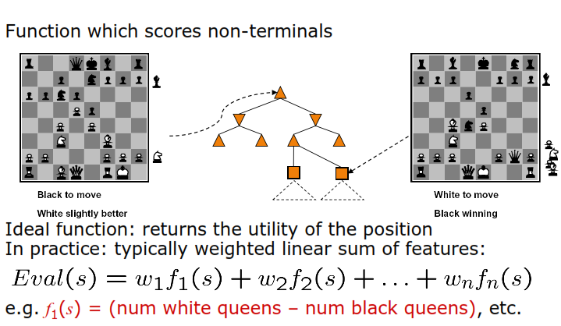
Evaluation Functions

Slide 46
Evaluation Functions
Material value for each piece in chess
Pawn: 1
Knight: 3
Bishop: 3
Rook: 5
Queen: 9
This can be used as weights and the number of each kind can be used as features
Other features
Good pawn structure
King safety
These features and weights are not part of the rules of chess, they come from playing experience

Slide 47
Cutting off search
MinimaxCutoff is identical to MinimaxValue except
Terminal? is replaced by Cutoff?
Utility is replaced by Eval
Does it work in practice?
b^{m} = 10⁶, b=35 → m=4
4-ply lookahead is a hopeless chess player!
4-ply ≈ human novice
8-ply ≈ typical PC, human master
12-ply ≈ Deep Blue, Kasparov

Slide 48
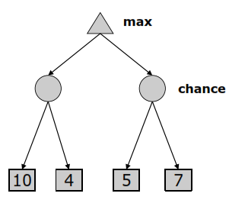
Expectimax Search Trees
What if we don’t know what the result of an action will be? E.g.,
In solitaire, next card is unknown
In minesweeper, mine locations
In pacman, the ghosts act randomly
Games that include chance
Can do expectimax search
Chance nodes, like min nodes, except the outcome is uncertain
Calculate expected utilities
Max nodes as in minimax search
Chance nodes take average (expectation) of value of children

